Slide 1
Moonshot Project
Jason GROSSO 2023-2024

Slide 2
Table of Contents
1
2
3
4
5
6
Subject
How a Categoriser Works
How to Apply it to Files
Demonstration
Future Improvements
Conclusion

Slide 3
The Subject
Categoriser

Slide 4
Some Definitions
Scope
Spaghetti Code
Legacy Code

Slide 5
How a Categoriser Works
Identify
Isolate
Store

Slide 6
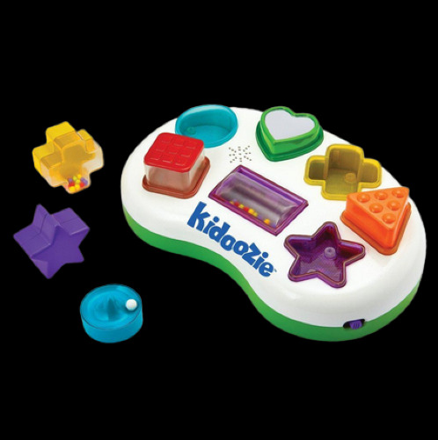

Identify
Is this the same as that?

Slide 7
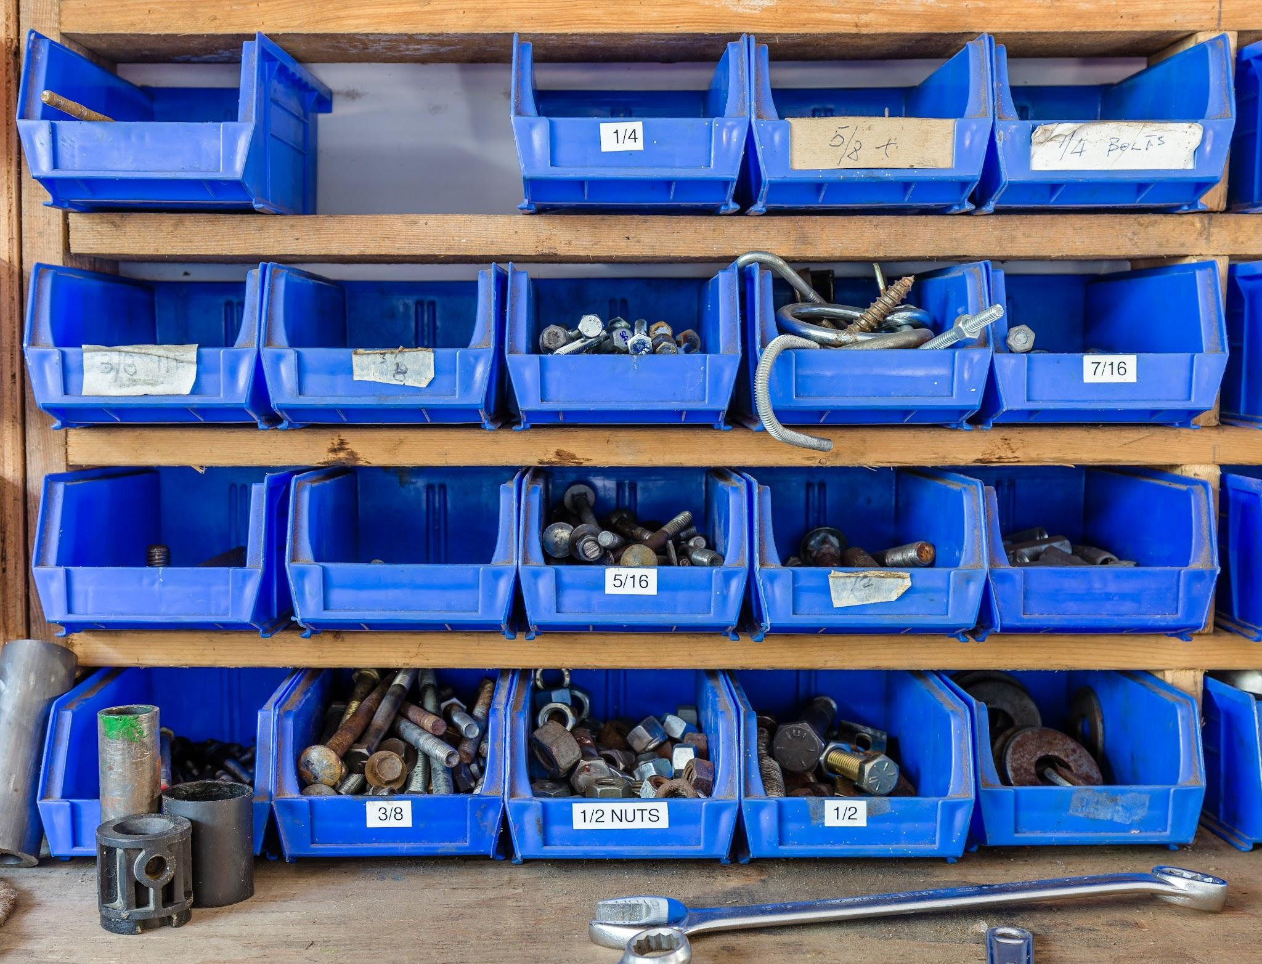
Store

Slide 8
How to Apply it to Files
Step by Step

Slide 9

const int a = 5;
int b = 5;
int main(){}
Token
Linked List

Slide 10
Demonstration

Slide 11
Future Improvements
Short Term
Fix output
Better paths
Rework the Isolation part
Prevent the console from closing

Slide 12
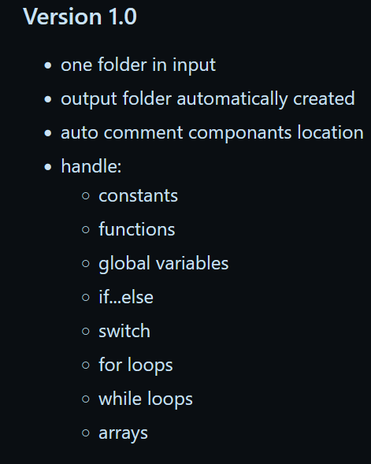
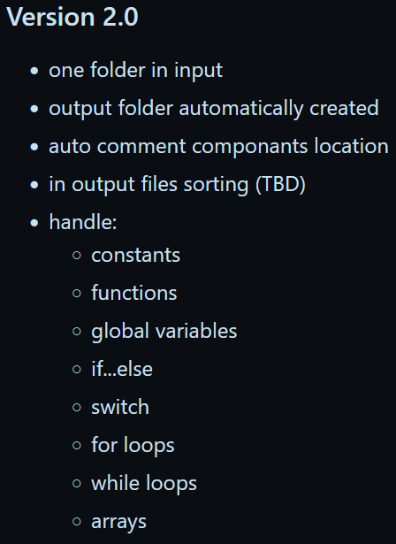
Future Improvements
Long Term

Slide 13
Conclusion

